Slide 1

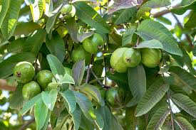
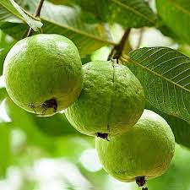
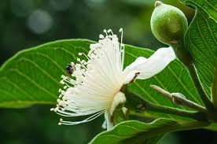
GUAVA

Slide 2
Common name: Guava
Scientific name: Psidium guajava
Family : Myrtaceae
Habit: Guava is a fast growing evergreen shrub or small tree that can grow to a height of 3-10m. It has a shallow root system. Guava produces low drooping branches from the base and suckers from the roots.
It can be found in tropical and subtropical areas.
Distribution: Guava is native to central and northern South America but have spread to many tropical and subtropical regions.

Slide 3
Description
Height Of Tree: About 20ft. (1m)
Leaves: Guava leaves are oblong to oval-shaped, with a leathery surface and faint white veins.
Flower: Guava flowers are white and have four to five elliptic petals and many white stamens.
Fruits: Guava fruit is a berry. The colour of guava is red and white and contains seeds. Fruiting occurs during June to September.
Bark of tree: The bark is pale, mottled and smooth.
Seeds: edible, have a strong smell, and can be white or pink in colour. They are firm.

Slide 4
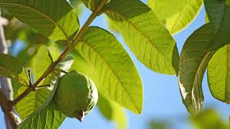
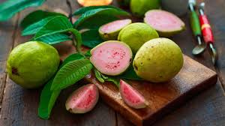
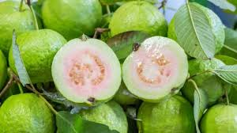
USES

Slide 5
USES:
The guava FRUIT is a source of vitamin C, fiber, which stimulates bowel movements and improves digestion.
The guava leaf for stomach and intestinal conditions, pain, diabetes, and wound healing.
The health benefits of guava are derived from its many properties, including antioxidant, antidiabetic, antihypertensive, anti-inflammatory.
can help lower blood sugar levels and decrease the chances of insulin problems.
guavas are relatively low in calories and high in fiber, they are a satisfying and healthy snack that fits perfectly in a weight loss plan.
guava leaf extract may bring relief for dysmenorrhea, or menstrual cramps. The same substance may also help ease toothaches.

